Slide 2
AMBASSADOR TRAINING: FOUNDERS’ DAY
Agenda:
Ambassador Role
Ambassador Resources
Creating a personal fundraising link
Creating your personal appeal/program appeal
Fundraising challenges / prizes

Slide 3
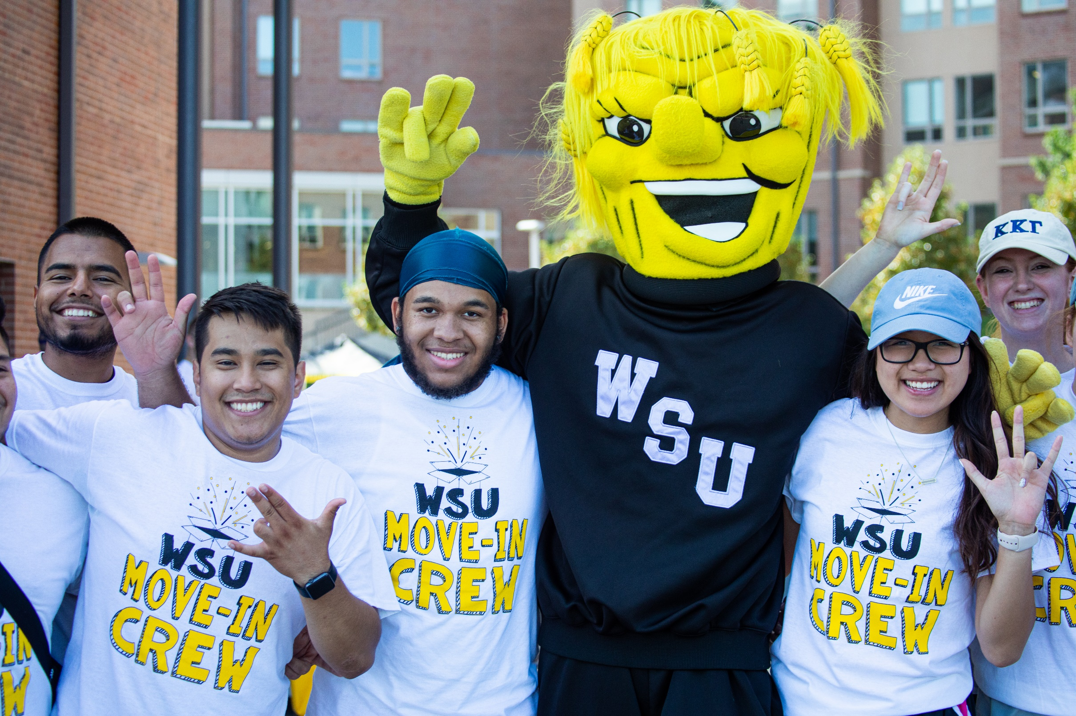
AMBASSADOR ROLE
Who are Founders’ Day ambassadors?
What are ambassadors responsible for?
When does the ambassador role begin?
How can you recruit other ambassadors?
Notes:
Our Founders’ Day ambassadors can be absolutely anyone who wants to support a program on campus. I believe most people on the call are the main point of contact for your individual programs, but please know that you can and should ask others to join you as an ambassador. If there are other staff members you work with, or students who use your services, ask them to become an ambassador with you and further the reach of your entire program.
That’s really the best summary of what ambassadors are responsible for – you help get the word out about what people can support, and fundraise for your individual program!
As far as when the ambassador role begins – for many of you it is already under way. In the next three weeks, we ask that you really kick this into gear as we approach Founders’ Day, sharing information about it across your online channels and in person, and we’re going to talk through some of the ways you can do that later in this session.
I touched on it a moment ago, but we really ask that you work hard to recruit additional ambassadors to support your cause. The more people we have sharing about Founders’ Day and how it impacts students, the greater impact we will be able to have. Ask your coworkers, faculty on campus and any students who are involved with your program. This is truly a “the more the merrier” kind of opportunity!

Slide 4
AMBASSADOR RESOURCES
www.foundation.wichita.edu/ambassadortoolkit
September 14
LIFTING SHOCKERS UP
wichita.edu/givingday

Slide 5
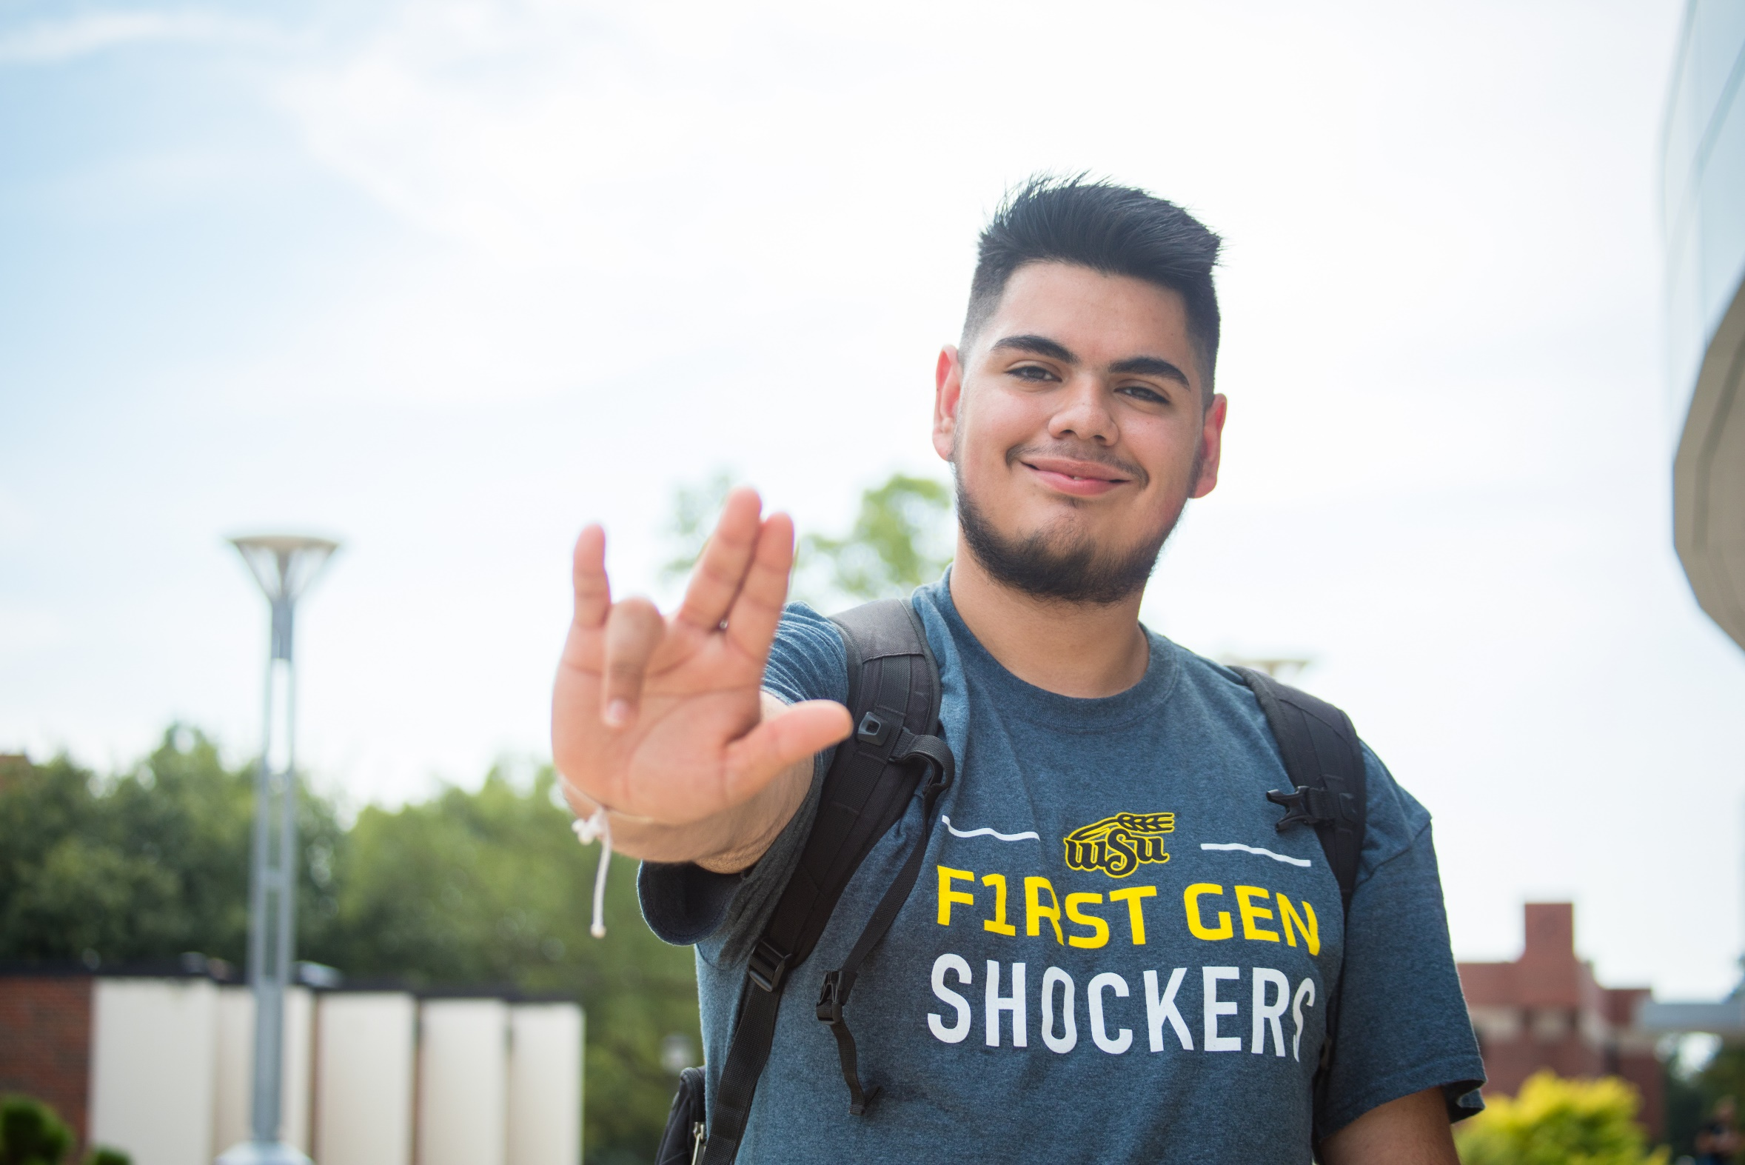
CREATING A PERSONAL FUNDRAISING PAGE
All of you have a unique program landing page
Every individual ambassador can become a “fundraiser” for the program with their own page and goals
September 14
LIFTING SHOCKERS UP
wichita.edu/givingday
Notes:
https://foundation.wichita.edu/givingday/
When you’re sharing from your program’s social media pages – the program landing page is the link you should share. You want people to be able to come straight here to give to your program. If you want, you can also include a link to our main landing page for people to browse all participating programs, but we highly encourage a more direct link. Our role is to promote everything – but we want your promotions to be more specific
Once on your individual page, you’re going to select the “Become a Fundraiser” button.
From here, set up a profile if you don’t already have one. – you’ll have to enter your name, email and a password, and then click continue.
If you already have a profile, it will take you to this fundraising page!
Be sure to upload a profile image. If a photo doesn’t auto populate for the header image, you can upload your own.
In the fundraising description, we recommend offering a brief statement about the program, but this is really a space for you to share your personal connection to the program and why you want people to support it.
Once you save your changes, you’ll be taken to your hub. If you sign up for multiple programs, this is where you will find them. You can share this directly on social from here, or you can copy and past the link.
(walk through other resources on the page)

Slide 6
CREATING YOUR PERSONAL APPEAL
What is your personal connection to the program?
How does your program benefit students?
Why are you an important part of the student experience?
September 14
LIFTING SHOCKERS UP
wichita.edu/givingday
Notes:
Now that you all know how to set up these personal pages, lets talk a little bit about creating your personal appeal. This is what you will share directly with your networks from your personal pages – so not from the organization page.
The first thing to think about is “why are you an ambassador for this program.” Why do you believe in it – what is your personal connection? This should shape all the information you share beyond that. Letting people know that you’re passionate about what you do and you have a reason for asking them for their support means they are more likely to give it.
Don’t shy away from being vulnerable here. I’m not sharing you need to share a sob story to pull at people’s heartstrings, but you should absolutely take this chance to let your passion and what drives your passion shine through. Personal appeals are truly what help people connect with your mission.
After you’ve established your why – think through how your program benefits students. What are some of the ways it improves the student experience? Think about students who have been a part of your program and the feedback they’ve given you – what were the specific things they said?
Next, it can be helpful to think about what would happen if your service was no longer available to students on campus. What gaps would it leave, and how does support ensure you can continue closing those gaps?
ACTIVITY: Submit in the chat “how does your program benefit students” in one sentence.
Some of these prompts are going to carry over to our next step, which is creating your programs direct appeal.

Slide 7
PROMOTING YOUR PROGRAM
Countdown to Founders’ Day
10 ways your program improves the student experience
Share student stories
Ask program alumni to share their own story
Give an example of how funding helps your program – what will these dollars go toward?
What does a $25 gift do for your program?
September 14
LIFTING SHOCKERS UP
wichita.edu/givingday
Notes:
You’ve already worked through what your program does and what your purpose is, so lets talk about how to share that with your program audiences on social. This is what you would share from your program’s official social accounts and pages.
As we are only three weeks away from Founders’ Day – you can start posting these things now! The one thing to keep in mind is that people cannot actually make a donation before Founders’ Day, unless they want to create a matching gift. So your posts should be about raising awareness about the day, and sharing how their donation the day of will make a difference.
We’ve put together a few of the ways you can promote your program over the next three weeks on this slide, and you can combine them or pick and choose, or come up with different strategies altogether.
The first is creating a Countdown to Founders’ Day – this can keep people clued in and prepared for the actual day of. You can easily end these posts with “10 days until Founders’ Day – do you know what program you’re going to support?” as more of a general appeal. Or “Bookmark this page now!”
Another option is to think about 10 different ways (doesn’t have to be 10) that your program improves the student experience. This can be integrated into your countdown, or be a standalone thing. But always remind people that Founders’ Day is coming.
Another way to showcase the features of your program is through student or alumni stories. As they people who have participated in your program or organization, they are some of your best advocates, and tagging them could lead to expanding your overall reach. (example: Shocker Bowling https://www.instagram.com/shockerbowling/) (example 2: SEAL https://www.instagram.com/p/CifoKimPgD-/)
One other important way to encourage people is to let them know exactly how their donation will help your program. So, what could you do with $25? Or $100? How big of an impact would those gifts make? Donors love to know how their funds are being used, so if you can tell them upfront the impact their gift will make, it encourages them to give in the first place.

Slide 8
FUNDRAISING CHALLENGES/PRIZES
Top two fundraising groups – personalized brick on the Shocker Walkway
Total amount raised is based on individually registered programs
Top three individual fundraisers – gift card to the Shocker Store
Total amount raised is based on your unique fundraising page within a program
September 14
LIFTING SHOCKERS UP
wichita.edu/givingday

Slide 9
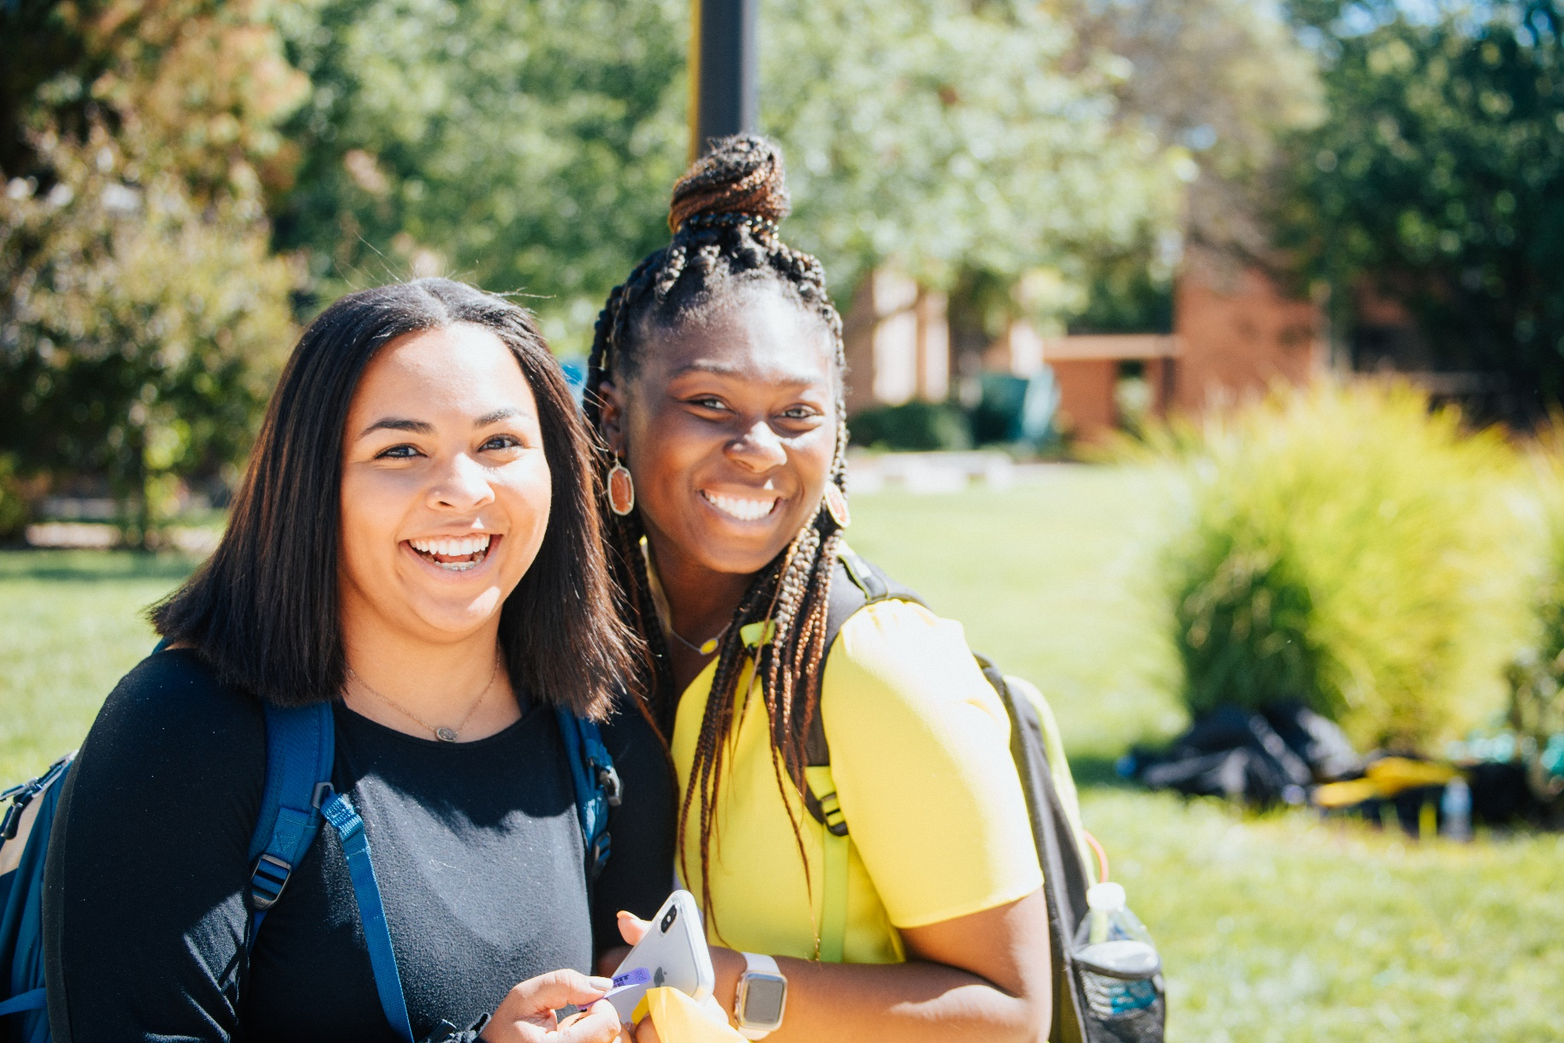
PROMOTING FOUNDERS’ DAY:
1
Plan timing of your posts
Start posting at two weeks out
Coordinate with your ambassadors to further your reach
Encourage program participants to share your content
Reshare WSUFAE promotional posts
Start emailing, calling and texting
Utilize our Ambassador Toolkit for prompts and conversation outlines
Celebrate Founders’ Day and share your Shocker Pride!
2
3
4

Slide 10
FOUNDERS’ DAY SUPPORT TEAM
We are available to answer questions or set up a team-specific meeting to share more about how to have a successful Founders’ Day.
MATCHING GIFT SUPPORT
REGISTRATION SUPPORT
AMBASSADOR/MARKETING SUPPORT
Emily Mullins
Matt Fisher
Aaryn Bennett
emily.mullins@wichita.edu
matt.fisher@wichita.edu
aaryn.bennett@wichita.edu
Nate Koch
Jordan Gaylord
Nolan Berning
nate.koch@wichita.edu
jordan.gaylord@wichita.edu
nolan.berning@wichita.edu
Stacie Williamson
stacie.williamson@wichita.edu

